Slide 1
Customer Purchase Prediction
Blessing Itodo
Artificial Intelligence Final Project

Slide 2
Project Overview
• Goal: Predict likelihood of customer purchasing
Data: Multiple datasets on consumer behavior & reviews
Methods: Random Forest, baseline models, EDA
Outputs: Feature importance, accuracy, insights

Slide 3
Project Overview cont
This project develops a machine learning model to predict customer purchasing decisions using Random Forest classification algorithms. By analyzing demographic data and historical purchasing behavior, the model aims to identify key factors that influence buying decisions, enabling businesses to optimize marketing strategies and improve customer targeting.

Slide 4
Objectives
● Build and train a Random Forest classifier to predict product purchase likelihood
● Identify the most influential features driving customer purchase decisions
● Analyze consumer behavior patterns across different demographic segments
● Provide actionable insights for targeted marketing campaigns

Slide 5
Theory Behind the AI Model
Machine Learning classification using Random Forest
Ensemble learning improves prediction accuracy & robustness
Uses decision trees, bootstrapping, and feature randomness
Suitable for mixed data types and nonlinear relationships

Slide 6
Local Impact of AI
Helps local businesses optimize marketing strategies
Enhances customer targeting and personalization
Supports small retailers in resource allocation
Improves customer service and product recommendation systems

Slide 7
Global Impact of AI
Drives automation across industries worldwide
Enables large-scale personalization in e-commerce
Helps global corporations predict market trends
Expands opportunities in AI-driven business intelligence

Slide 8
Key Insights From the Model
• High-impact features identified (income, sentiment, recency)
• Model accuracy
• Behavior trends
• Visual insights generated from dataset

Slide 9
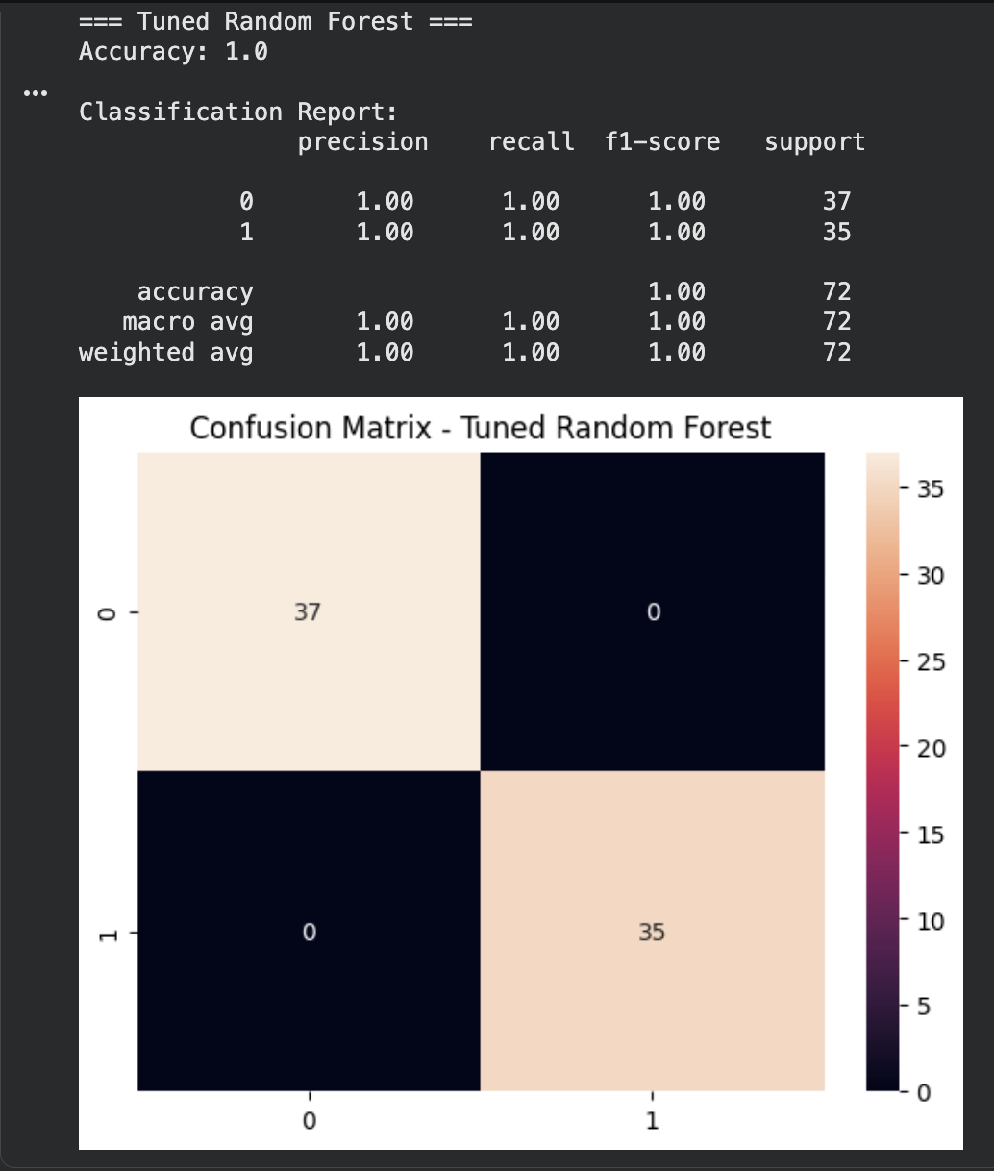
Classification Report

Slide 10
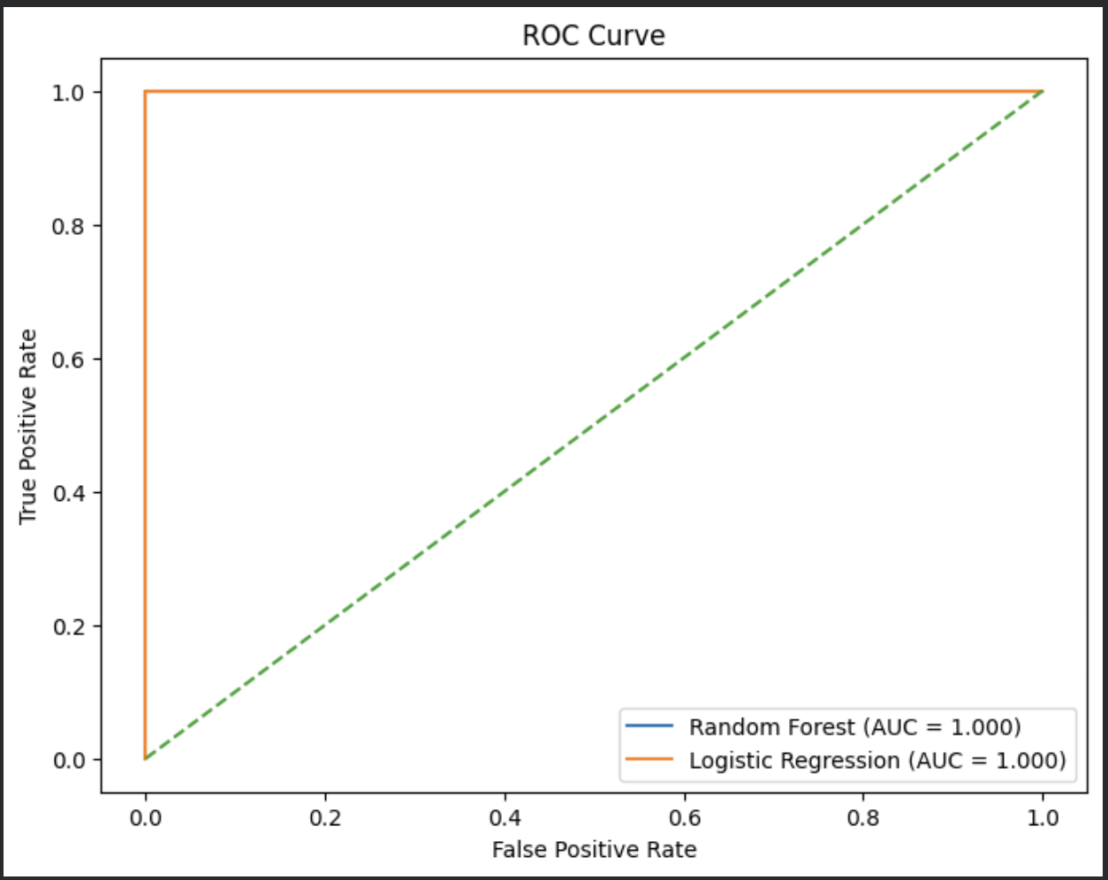
ROC Curve

Slide 11
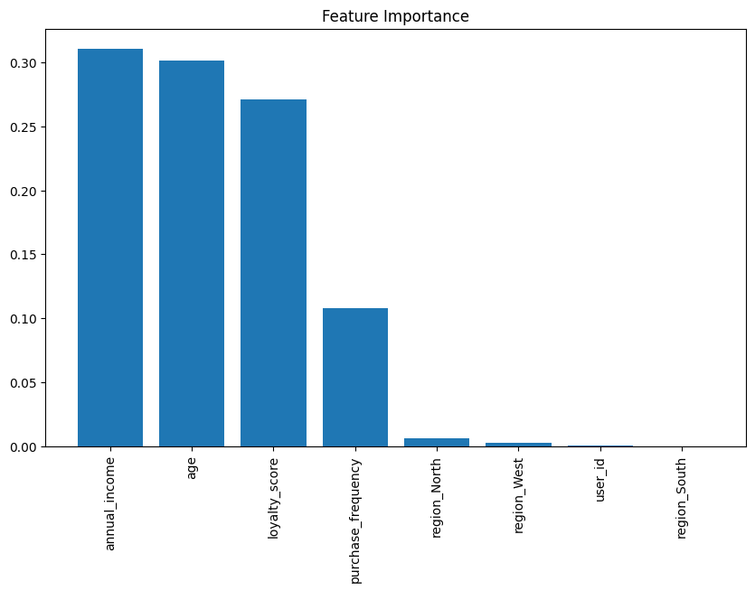
Customer Behavior based on Features

Slide 12
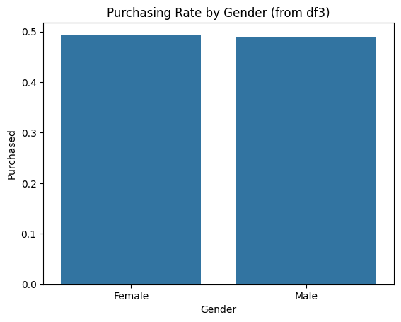
Purchase by Gender

Slide 13
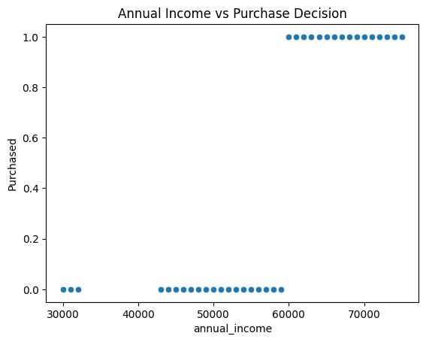
Purchase by Income

Slide 14
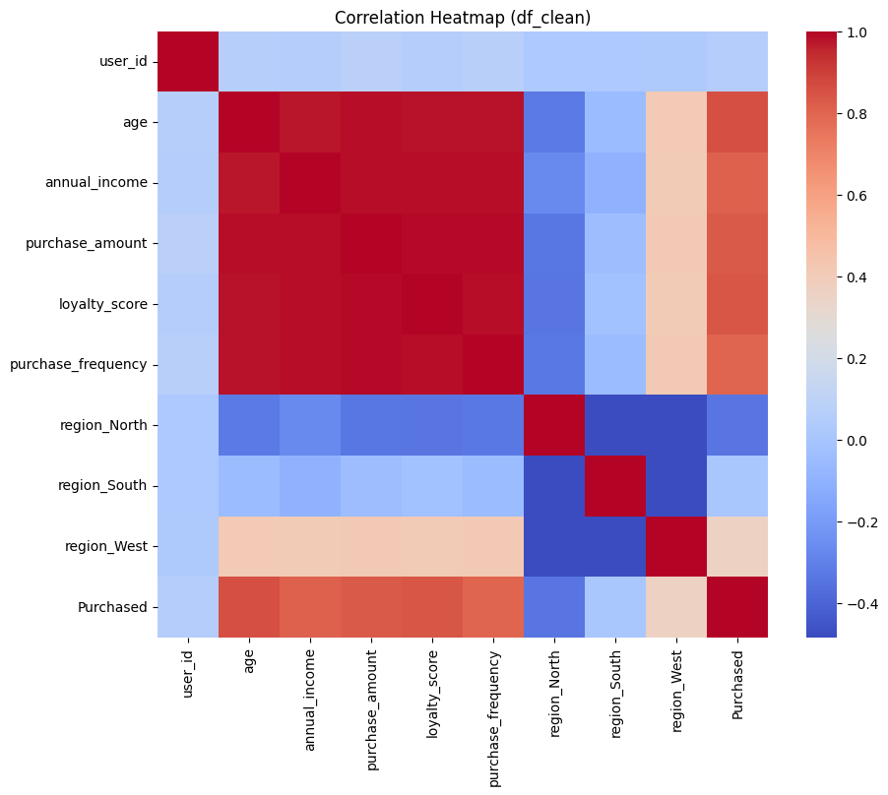
Correlation Matrix

Slide 15
Conclusion
AI models like Random Forest improve purchase prediction
• Data-driven marketing enhances customer engagement
• Ethical use and transparency are essential for real-world AI
• Future work: Add deployment, dashboard, or real-time API, data governance/ethical considerations, create an interface to use personal data

Slide 16
Reference
Customer Purchasing Behaviors
Primary dataset for behavioral pattern analysis
Consumer Behavior and Shopping Habits
Supplementary data for shopping habit trends
E-Commerce Customer Behavior
Online shopping behavior patterns

